Slide 1
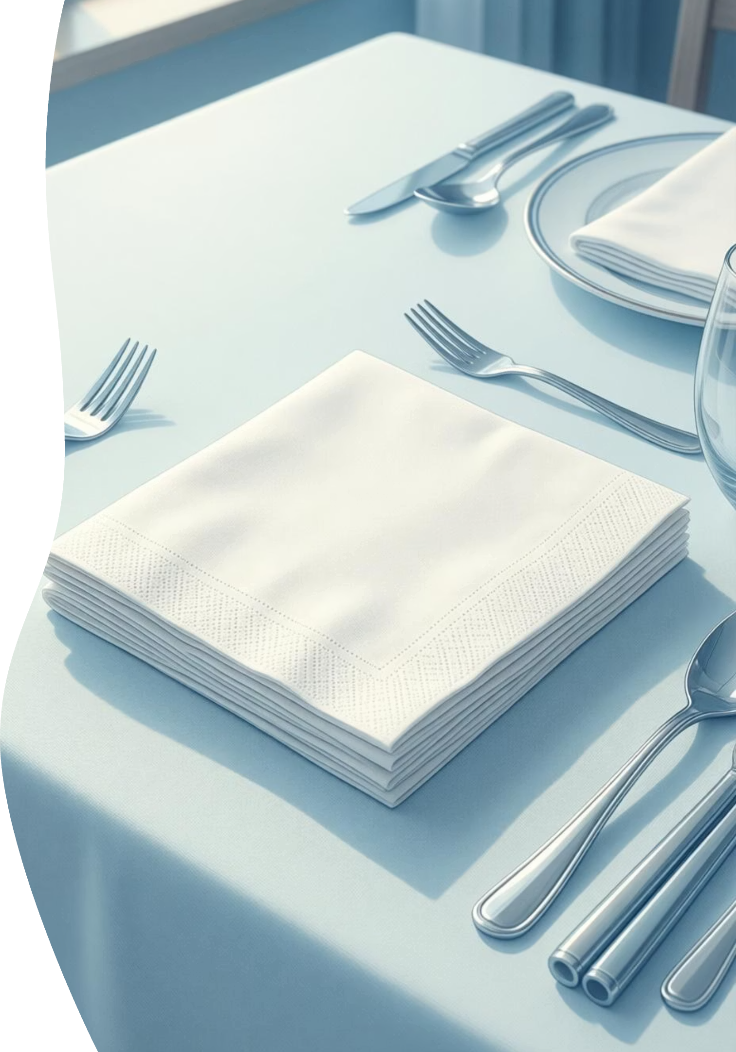
Napkin: A Simple Solution for Everyday Cleanliness
Exploring the design, function, and evolution of an essential hygiene product

Slide 2

PROBLEM
The Daily Challenge of Maintaining Cleanliness
During Meals
In Public Spaces
Food and beverages can easily spill or leave residue on hands and face, creating discomfort and potential hygiene concerns throughout the day.
Shared environments require quick, convenient ways to clean up without disrupting activities or social interactions.
The Need
While Traveling
A portable, disposable, and effective tool that provides immediate cleanliness without requiring water or additional resources.
Limited access to washing facilities makes it difficult to maintain proper hygiene when eating on the go or handling messy items.

Slide 3





OBJECTIVES
Product Development Goals
Hygiene Assurance
User Comfort
Provide a reliable barrier against germs and maintain cleanliness in diverse settings
Design with soft, gentle materials that are safe for all skin types and comfortable to use
Universal Access
Environmental Consideration
Create an affordable, widely available product suitable for all demographics and occasions
Balance convenience with sustainability through thoughtful material selection and disposal methods

Slide 4
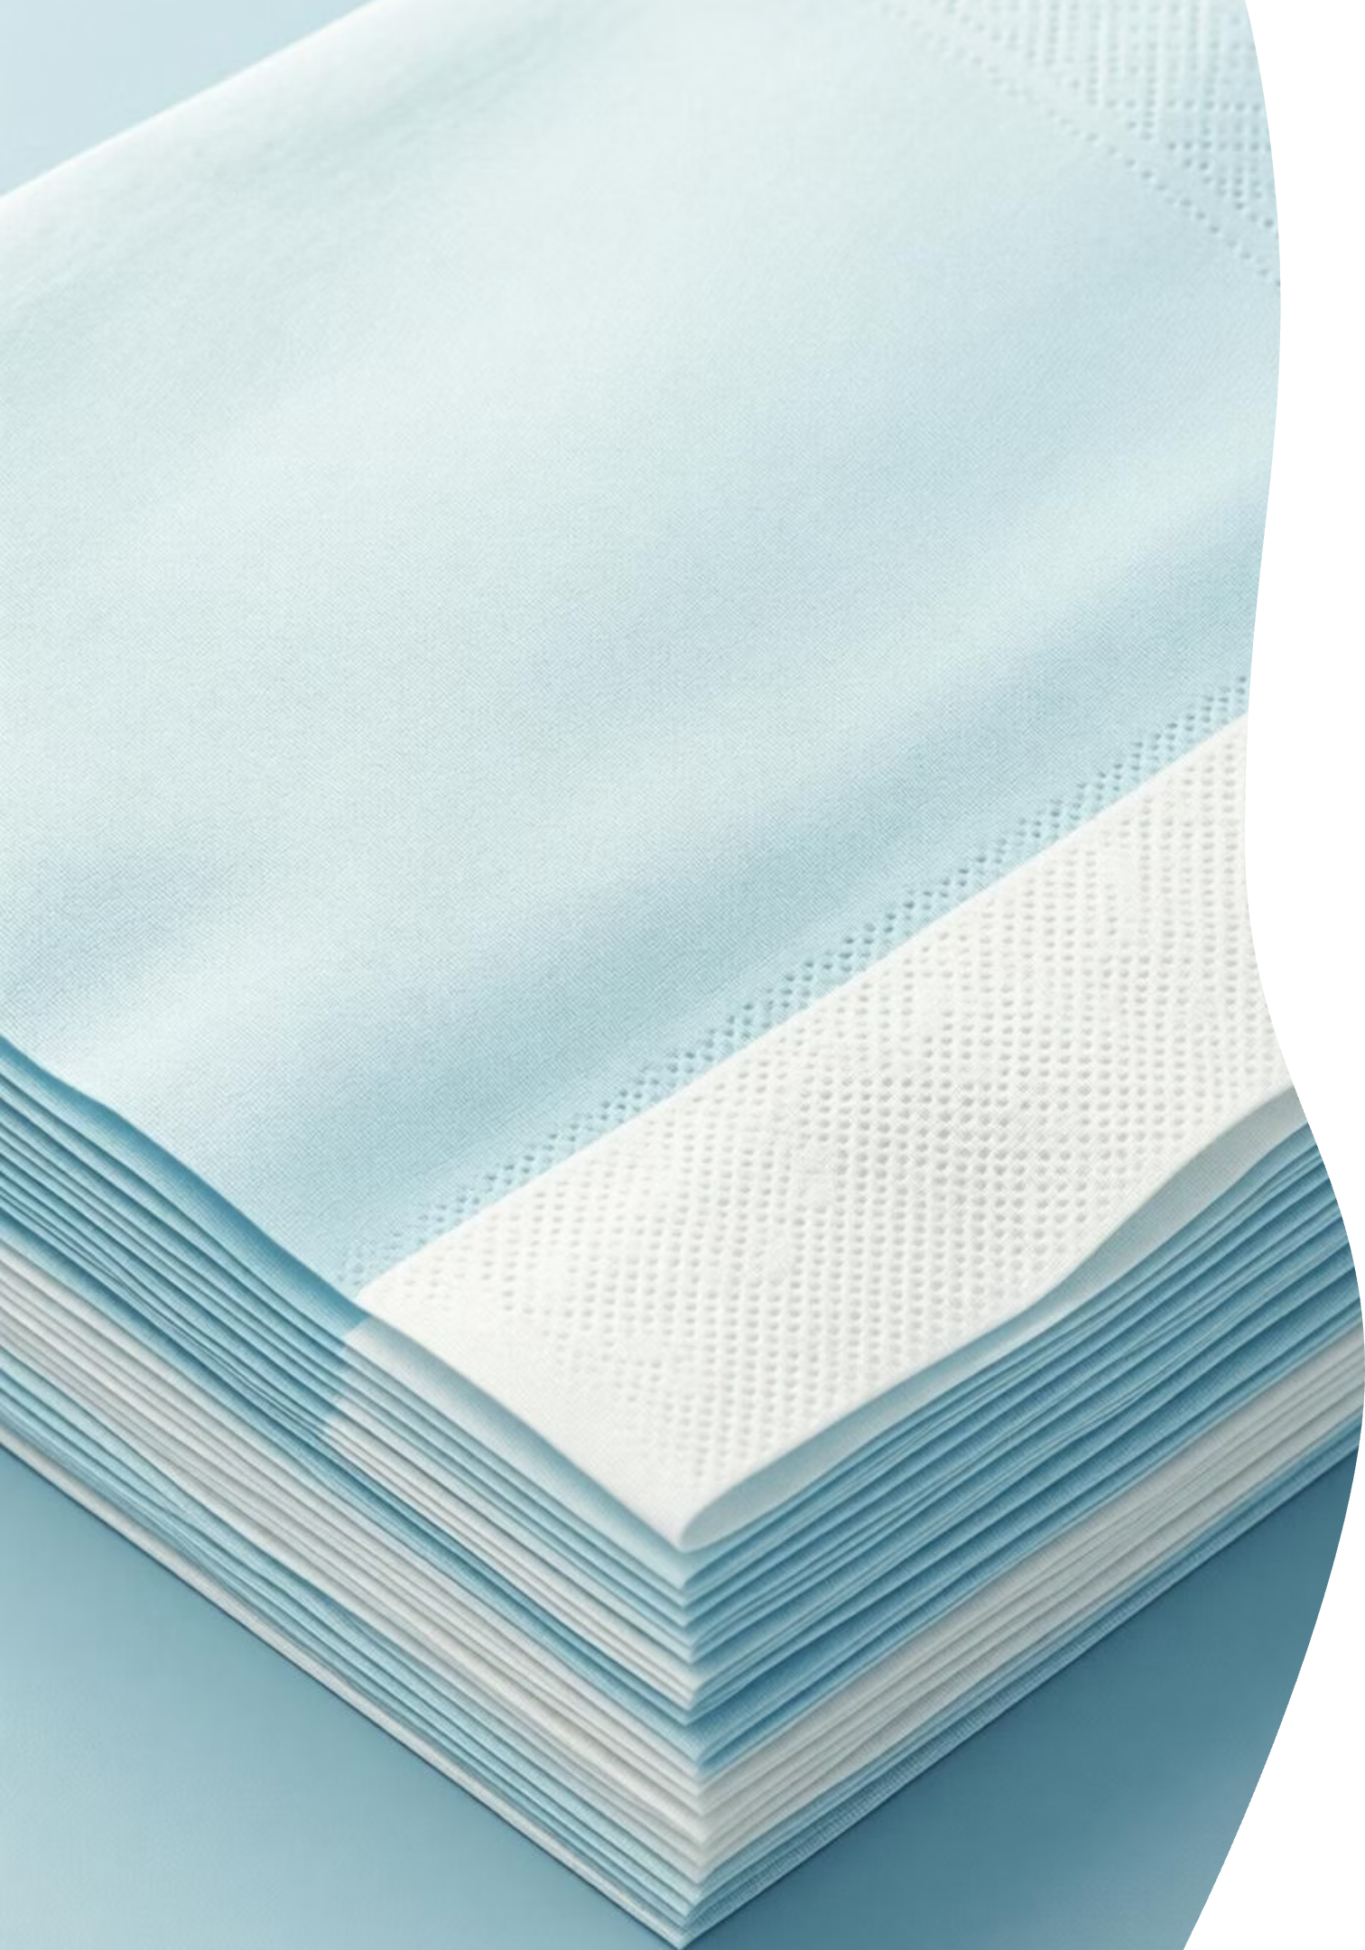

SOLUTION
The Napkin: Simplicity Meets Functionality
Absorbent Material
Portable Design
Constructed from soft paper or fabric designed to quickly absorb liquids and capture particles
Compact and lightweight for easy storage in pockets, bags, or on restaurant tables
Immediate Action
Ready to use instantly without requiring water, soap, or any preparation time

Slide 5
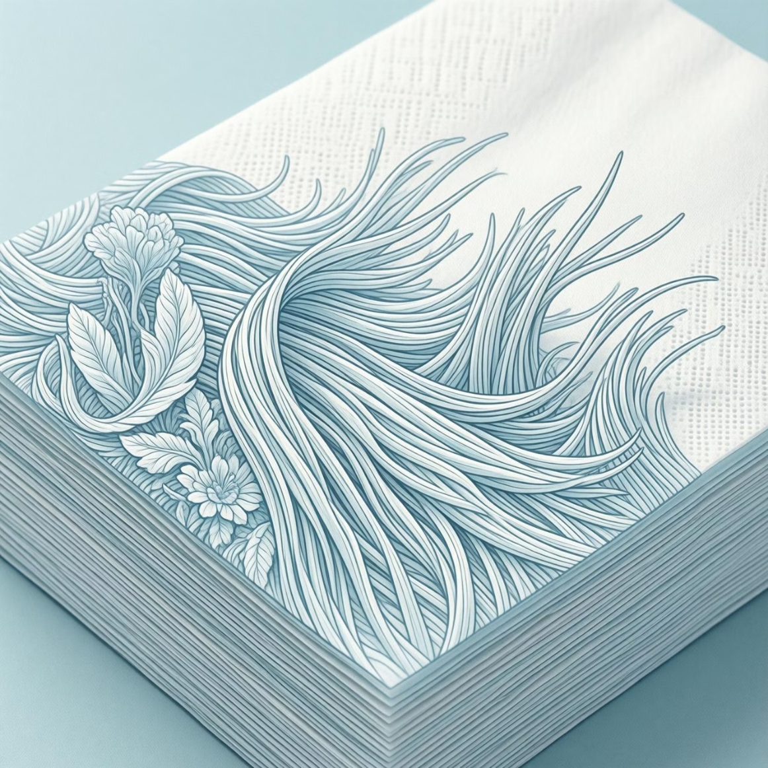
Product Structure and Components
01
Base Material
Paper pulp or woven fabric forming the foundation layer
02
Absorbent Core
Multiple layers creating thickness and liquid-holding capacity
03
Surface Texture
Embossed or smooth finish optimized for cleaning effectiveness
04
Edge Treatment
Finished borders preventing tearing and maintaining structural integrity

Slide 6



HOW IT WORKS
The Working Principle
Capillary Action
Absorption Process
Clean Surface
Tiny spaces between fibers draw liquid inward through surface tension
Material traps moisture and particles within its layered structure
Skin or surface left dry and clean after gentle wiping motion
The napkin's effectiveness comes from its porous structure, which maximizes surface area contact while maintaining strength. Gentle pressure during use ensures optimal absorption without tearing or leaving residue behind.

Slide 7


Key Advantages
Convenient & Accessible
No washing required
Disposable after single use
95%
Available everywhere
Extremely affordable
Versatile Applications
Suitable for homes, restaurants, travel, picnics, and emergency situations
Liquid Absorption
Captures spills effectively
Highly Effective
Removes food residue efficiently
Works on various surfaces
Quick-acting solution

Slide 8
CHALLENGES
Obstacles and Limitations
Environmental Impact
Limited Durability
Single-use paper napkins contribute significantly to waste generation. Most end up in landfills where they take weeks to months to decompose, especially when contaminated with food waste.
Paper napkins can tear easily when wet or under pressure. They may require multiple units for a single cleanup, reducing efficiency and increasing waste.
Material Sourcing
Storage and Preservation
Traditional production relies heavily on tree pulp, contributing to deforestation. Balancing cost, quality, and environmental responsibility remains challenging for manufacturers.
Napkins must be kept dry and protected from contamination. Improper storage can compromise hygiene and reduce effectiveness.

Slide 9
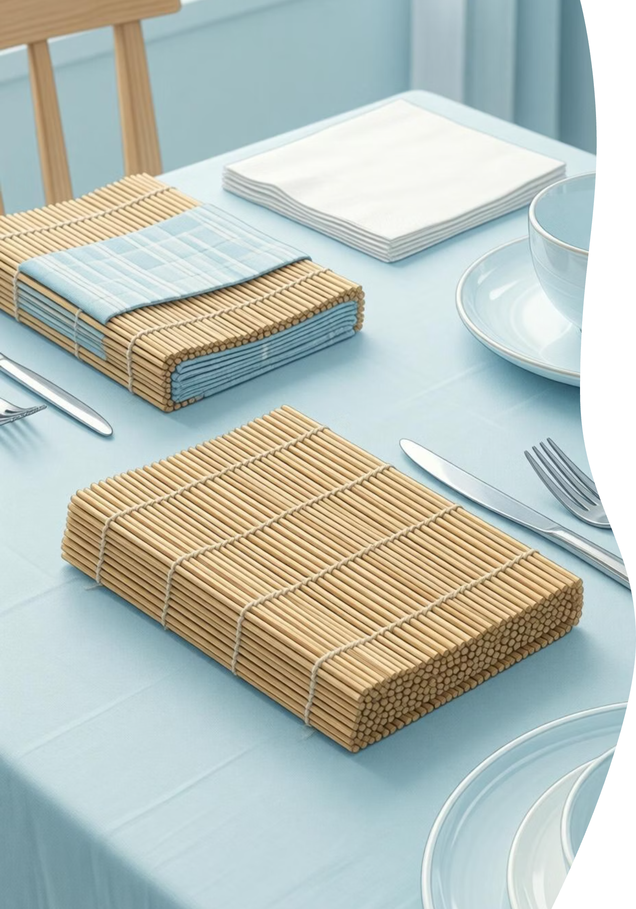




Future Improvements and Innovation
Sustainable Materials
Transition to bamboo, recycled paper, or plant-based fibers that decompose faster and require fewer resources to produce
Enhanced Durability
Develop stronger fiber bonds and multi-layer designs that resist tearing while maintaining softness and absorbency
Biodegradable Options
Create napkins that break down naturally within weeks, even in marine environments, reducing long-term environmental impact
Reusable Alternatives
Promote cloth napkins for regular use and develop quick-dry fabrics that combine convenience with sustainability

Slide 10
Conclusion: Small Product, Big Impact
The napkin exemplifies how simple design can solve everyday problems effectively. Despite its humble appearance, it plays a crucial role in maintaining hygiene and comfort across countless daily situations.
Proven Effectiveness
Evolution Continues
Universal Value
Decades of use have confirmed the napkin as an indispensable hygiene tool for individuals and institutions worldwide
Ongoing innovation in materials and design promises more sustainable and effective solutions for future generations
The napkin's success lies in its accessibility, affordability, and ability to meet a fundamental human need with elegant simplicity
As we move forward, the challenge is to preserve what makes napkins effective while addressing environmental concerns through smarter design and material choices.

